Slide 1


Beyond Good and Evil:
Analyzing Washington Crash Files
Team IC23001
Members: Chaitanya Pohnerkar, Akhil Reddy, Jarrar Haider, Eeshan Agarwal
Organization Name: Washington Traffic Safety Commission (WTSC)
UMD Information Challenge 2023

Slide 2





We are first year graduate students at Robert H. Smith School of Business
Akhil Reddy
Chaitanya Pohnerkar
Jarrar Haider
Eeshan Agarwal
Jarrar Haider

Slide 3

On average, 534 fatal crashes are reported in Washington State yearly
Data of more than 4000 cities, counties and zip codes was analyzed in this analysis for insights, patterns and trends.
Meta data included 250+ variables for each data point (i.e., fatal crash incident)
The operative term “fatal” in this analysis means a crash which resulted in either death or serious injury

Slide 4
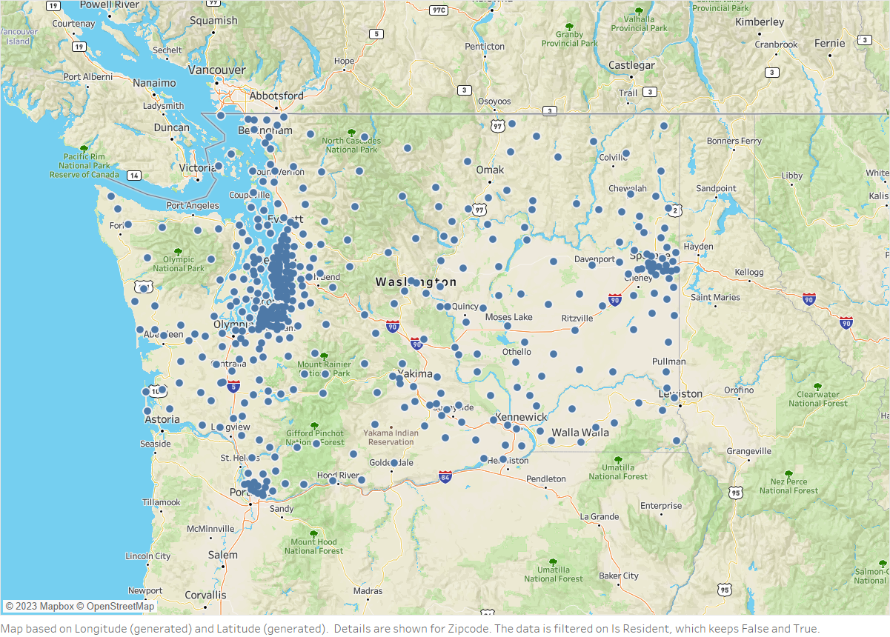

Slide 5
Among drivers involved in fatal crashes, what proportion are involved in crashes in communities where they live?

Slide 6
23%
Among drivers involved in fatal crashes, what proportion are involved in crashes in communities where they live?
Only 23% of the people who crash in a community belong to the very same community they crashed in. By “community”, we assume zip code. MAPBOX API was used to convert x, y coordinates of crash location to match it to its specific zip code, which was then compared with the driver’s zip code to calculate the proportion. This proves the hypothesis that an overwhelming majority of people involved in fatal crashes in a community are not resident of that area.

Slide 7
The % stays the same for border areas while it changes significantly for Seattle
In Seattle, the proportion for residents and non-residents is 18% and 82% respectively, a change of 5 percentage points
However in border areas the ratio is similar to the state average i.e., 23% resident, 77% non-residents

Slide 8
Are there differences in the types of crashes and behavior factors in those crashes among “residents” versus those deemed to be not “from” the area?

Slide 9
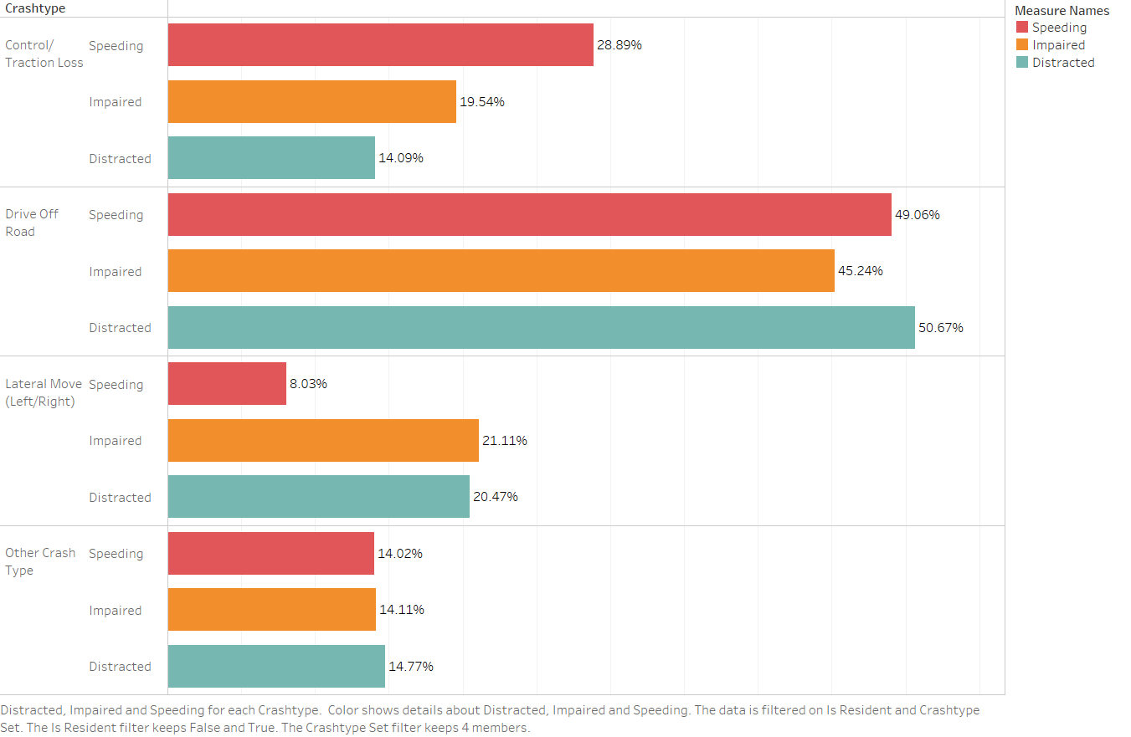
This graph shows the % of crashes by crash type and driver’s state i.e., under influence, over-speeding and/or distracted while driving
The top 4 crash types are picked for comparison only

Slide 10
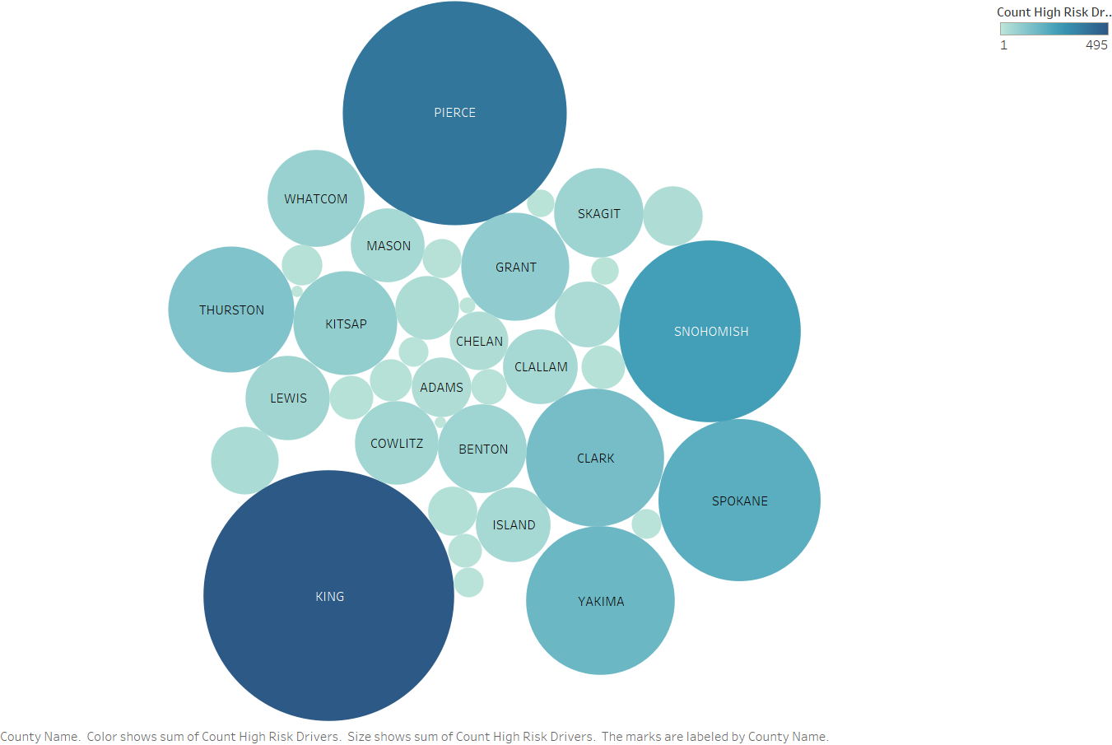
Are there specific resident ZIP Codes that tend to produce higher-risk drivers that are involved in fatal crashes at a higher rate?
Certain zip codes, and hence the counties, stood out as the ones producing higher-risk drivers
We consider a driver as higher-risk if they are involved in an activity while driving which puts their as well as others’ lives at risk such as drunk driving, over speeding etc.

Slide 11
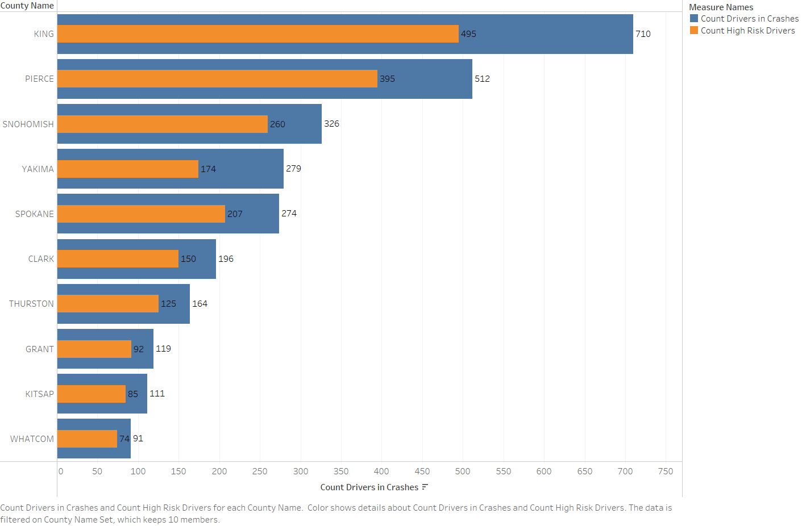
This graph shows the count of drivers involved in crashes (blue) and the count of those categorized as “high risk” (orange), divided by counties

Slide 12
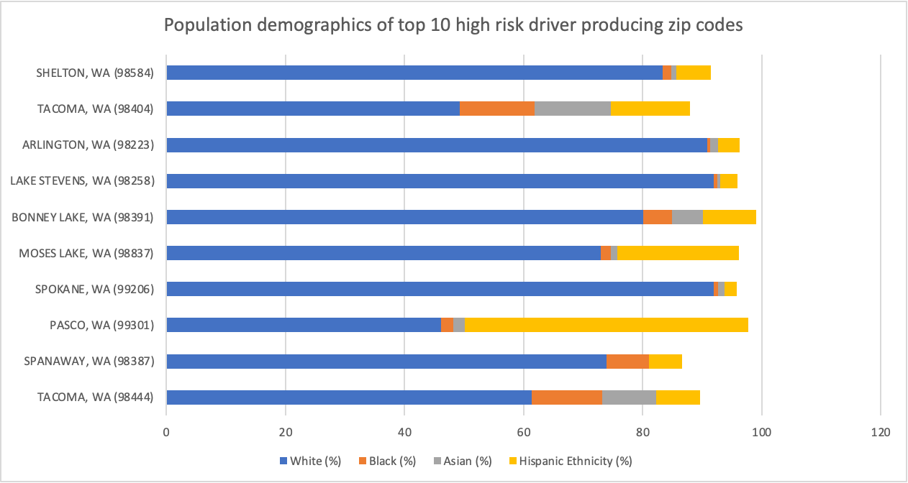
What are the population demographics of these high-risk driver producing ZIP Codes?

Slide 13
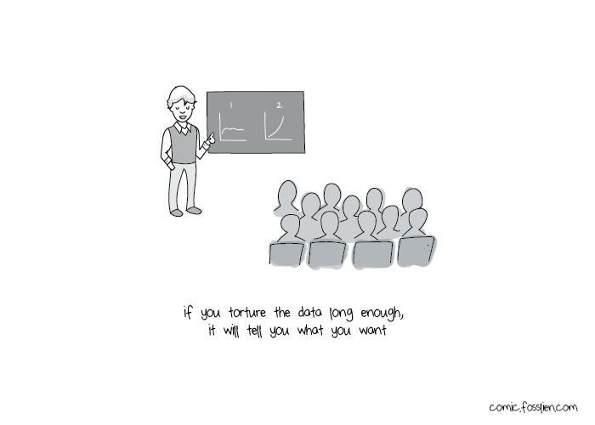

Slide 14
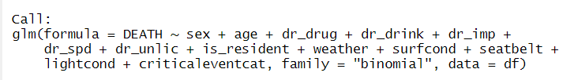
Certain behavior factors significantly increase the odds of death in case of an accident

Slide 15
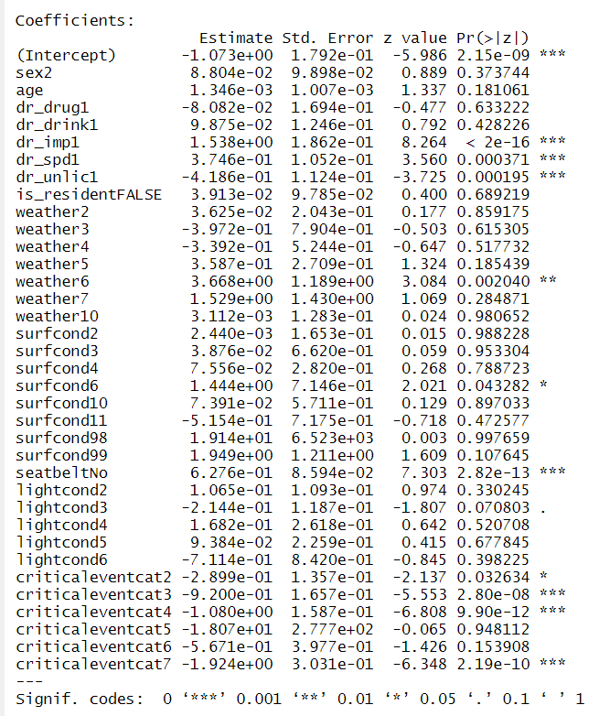
The fact that whether driver is impaired, speeding, is unlicensed or not wearing a seatbelt has significant impact on the odds of a death in the situation of a crash
Not wearing a seatbelt increases the odds of death by a multiplicative factor of 1.87, given all else is held constant!
Statistically significant coefficients implying the odds of a death in a crash are relatively less if the critical event leading to the accident falls into either of three

Slide 16
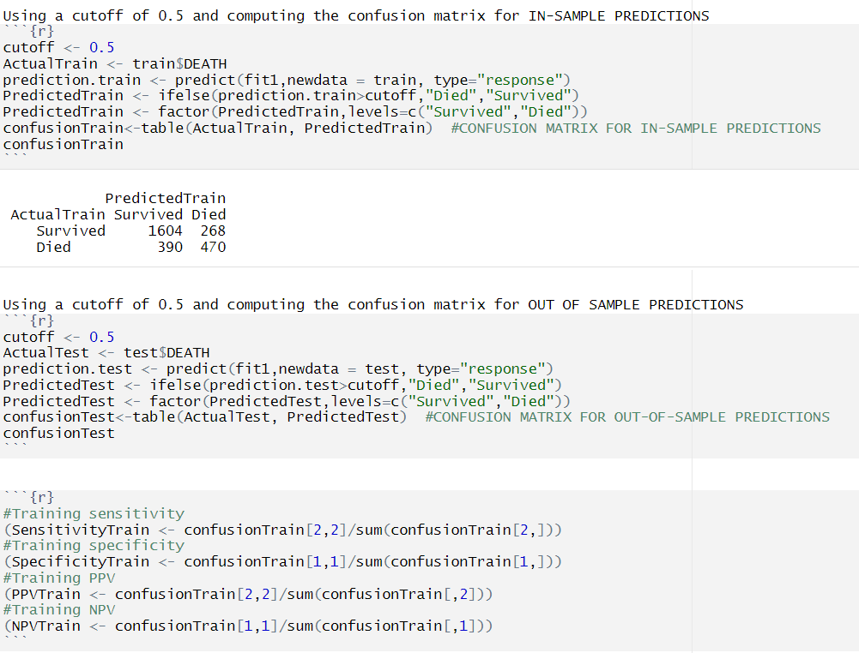
Our prediction model has an an out of sample accuracy of 77%
We partition the data into train and test, and both datasets to predict probabilities. We use the actual and the predicted values to compute a confusion matrix, which we use to find out the accuracy and error rate.
In-sample accuracy is 75% and out-of-sample accuracy is 77%

Slide 17
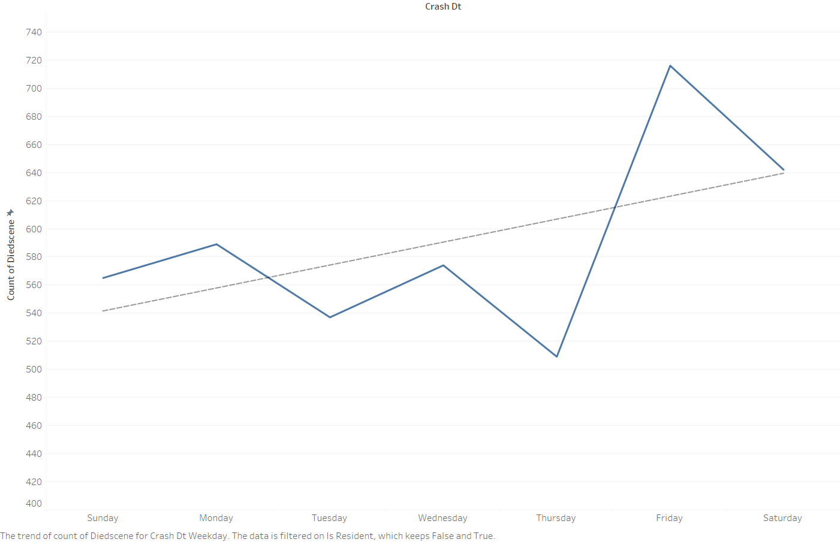
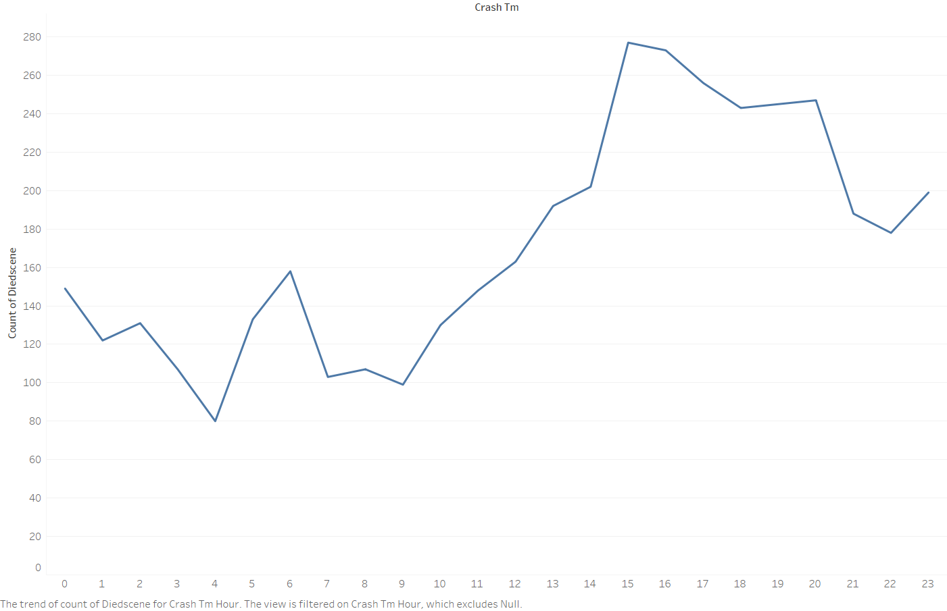
Time has an interesting correlation (which, of course, does not imply..causation!)
Frequency of crash by week of the day Frequency of crash in a 24 hours day

Slide 18
There is a stark difference in the locations where people live and the locations where they get into accidents
We conclude that although there are more non-residents who are involved in accidents in communities where they don’t belong to, the factors contributing to the crash are somewhat similar in both the classes albeit certain differences. Hence, an inclusive rather than targeted approach is the need of the hour.
More data is required for further analysis to ascertain causation for certain response variables.

Slide 19
Thank you for listening to our presentation
Let us know if you have any questions. Thank you!

Slide 20
Acknowledgement
We used the following datasets and APIs in addition to the data already provided:
https://www.census.gov/data.html
https://www.mapbox.com/
https://openai.com/blog/chatgpt

